Slide 1


  Network Infrastructure Security
  Physical Isolation vs. Logical Segmentation
  Stephen Reilly

Slide 2
Why Network Segmentation Matters
The principle of defense in depth requires layered boundaries
Without segmentation, a single compromise can spread laterally across the entire network
Segmentation limits the blast radius of an attack
Two fundamental architectural approaches exist:
Physical isolation — no network path between zones
Logical segmentation — network path exists but is controlled by policy

Slide 3
Physical Isolation: Air-Gapped Networks
Definition: No physical network connection between the isolated segment and any external network
Key characteristic: Communication requires physical media transfer (USB, removable disks)
Trust model: If there's no wire, there's no remote attack path
No network path means no network-based attack - it shifts the attack surface to physical and supply chain vectors

Slide 4
Air Gap: Security Strengths
Strongest perimeter boundary — eliminates entire classes of remote network attacks
No exposure to internet-based scanning, exploitation, or MITM
Aligned with regulatory requirements:
NIST SP 800-82 (ICS/SCADA guidance)
NERC CIP (electric utilities)
Simple, unambiguous trust model
Air gaps are often mandated, not merely recommended, for critical infrastructure - it's a compliance requirement in many sectors.

Slide 5
Air Gap: Security Weaknesses
Removable media is the primary threat vector
Example: Stuxnet (2010) — crossed air gap via USB, targeted Iranian nuclear centrifuges (See next slide for the juicy deets)
Insider threats — intentional or coerced bridging of the gap
Supply chain attacks — compromised hardware/firmware installed in isolated environment
Side-channel risks — acoustic, electromagnetic, thermal exfiltration (largely theoretical)
High operational cost: duplicate infrastructure, delayed patches, administrative overhead

Slide 6
Stuxnet
Discovery: June 2010 (Virus Bulletin conference)
Type: Worm targeting industrial control systems (Siemens PLCs)
Objective: Disrupt Iran's uranium enrichment at Natanz facility
Impact: ~1,000 centrifuges destroyed through physical manipulation while masking abnormal readings from operators
Innovation: First publicly known malware to cause kinetic/physical damage
Propagation: USB drives + network sharing; exploited four zero-day vulnerabilities
Attribution: Widely attributed to US (NSA) and Israeli intelligence cooperation (Operation Olympic Games), though never officially confirmed
Legacy: Established precedent for cyber warfare as a strategic tool; sparked global awareness of critical infrastructure vulnerability

Slide 7
Logical Segmentation: SDN Overview
Definition: Separating network traffic through software-controlled policies rather than physical disconnection
Traditional approach: VLANs + firewalls
Software-Defined Networking (SDN):
Decouples control plane (decision-making) from data plane (forwarding)
Centralized controller manages flows across the entire fabric
Enables microsegmentation — granular, per-workload policies
The control plane decides where packets go; the data plane executes those decisions. In SDN, the control plane moves from individual switches to a central software controller, which changes both the security capabilities and the threat model.

Slide 8
SDN: Security Strengths
Dynamic, granular policies — enforce at workload or flow level
Microsegmentation — controls east-west traffic, not just north-south
Limits lateral movement even within a data center
Centralized visibility — controller sees all flows across the fabric
Automated response — quarantine a host in seconds via policy update
Integration with SIEM, SOAR, and threat intelligence for automated defense
With SDN, a security orchestration platform can push a policy change in seconds - microsegmentation is one of the foundational technologies behind zero-trust architectures

Slide 9
SDN: Security Weaknesses
Controller as single point of compromise — controls the entire network fabric
Must be hardened, redundant, and strictly access-controlled
Configuration complexity — misconfigurations can inadvertently open cross-segment traffic
Hypervisor dependency — VM escape or hypervisor compromise undermines all logical boundaries
Maturity and vendor risk — proprietary implementations may have undiscovered vulnerabilities
Logical segmentation ≠ physical boundary — a path exists, it's just policy-denied
The controller becomes the crown jewel of the network — if it falls, the attacker controls traffic routing everywhere – Example: VMware NSX Exploitation Campaigns (2022–2024) (See next slide for the juicy deets)

Slide 10
VMware NSX Exploitation Campaigns (2022–2024)
Timeline: December 2022 – October 2024 (active exploitation window)
Primary Targets: VMware NSX Manager, vCenter Server, ESXi hypervisors
Key Vulnerabilities Exploited: CVE-2021-39144 — Unauthenticated RCE in NSX Manager, CVE-2023-34048 — Critical vCenter Server zero-day (used for ~3 years), CVE-2024-37085/6/7 — Authentication bypass (CVSS 9.8, critical), CVE-2024-38817/8 — Command injection + privilege escalation
Threat Actors: Chinese state-sponsored groups (UNC2452/APT41) — backdoor deployment (VirtualPita/VirtualPie), Ransomware operators (Black Basta, Akira) — privilege escalation + lateral movement
Attack Chain: Initial access → VM compromise → hypervisor escape → network-wide control via SDN controller
Impact: Hundreds of organizations globally; cross-VM data access; ransomware mass encryption campaigns
Attribution: NSA publicly reported vulnerabilities; US Government advisory warnings
Remediation: VMSA-2024-0020, VMSA-2024-0013 patches; Microsoft recommended immediate patching
Significance: Demonstrated SDN control plane as high-value target; challenged virtualization isolation assumptions

Slide 11
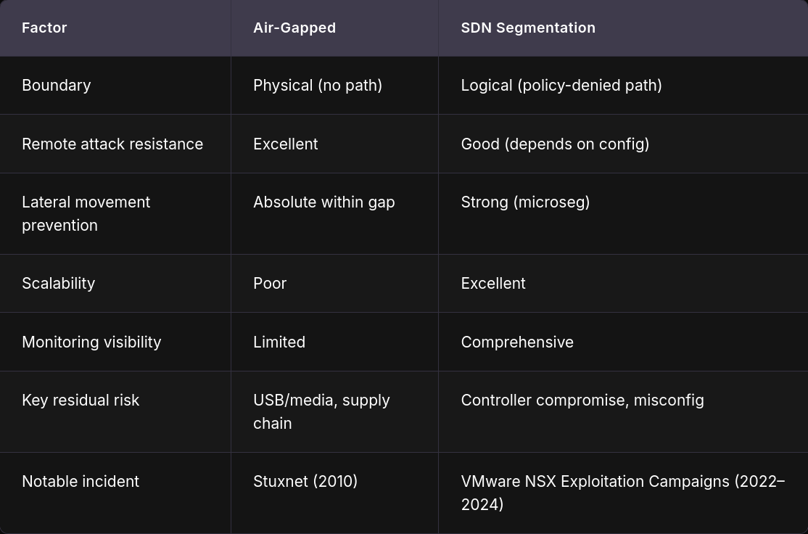
Side-by-Side Comparison

Slide 12
Hybrid Approaches & Best Practices
Many organizations use both approaches layered together
Air-gapped core for crown-jewel systems
SDN-based microsegmentation for the broader enterprise
Defense in depth principle: no single boundary should be your only boundary
Best practices:
Enforce strict USB/device policies on air-gapped networks
Harden and segment SDN controllers (dedicated management network, MFA, RBAC)
Continuous configuration auditing for logical segmentation
Regular penetration testing of both physical and logical controls

Slide 13
Key Takeaways
Air gaps provide the strongest boundary but shift risk to physical and supply chain vectors — and carry high operational cost
SDN segmentation provides flexibility, visibility, and speed but introduces controller risk and configuration complexity
Neither approach is sufficient alone — layered defense is the standard
Architecture choice depends on threat model, regulatory requirements, and operational needs
Know your crown jewels — protect the most critical assets with the strongest available boundary
Security architecture is risk-driven, not dogma-driven
The right answer depends on what you're protecting, from whom, and under what operational constraints

